Slide 1

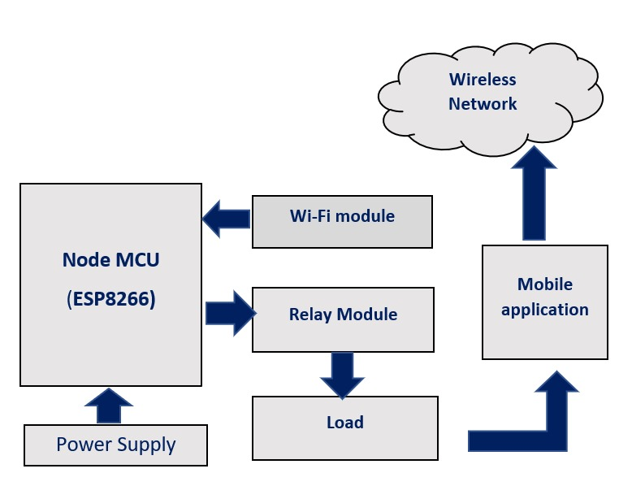
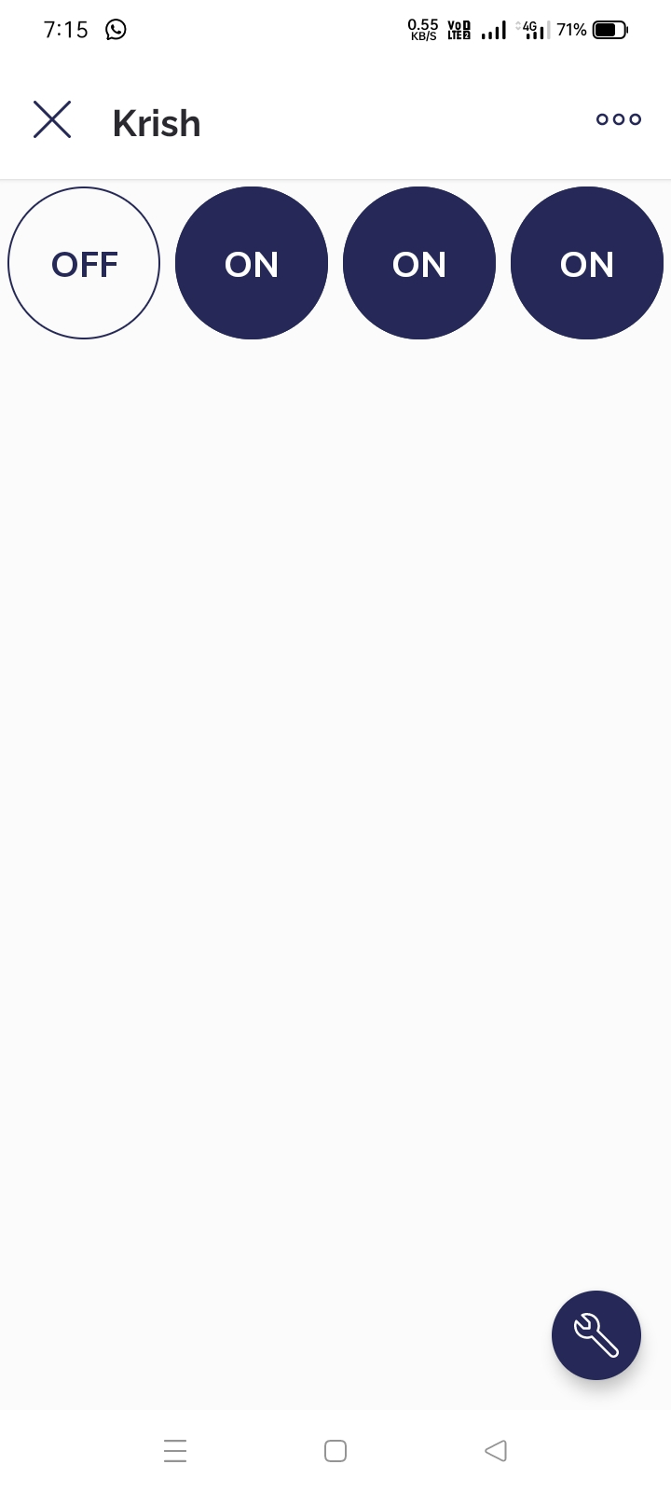
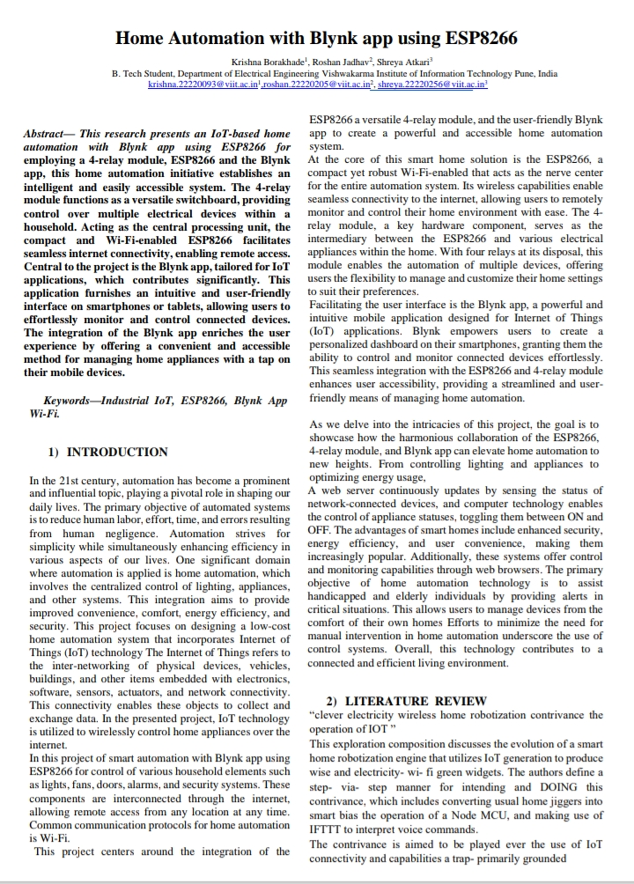
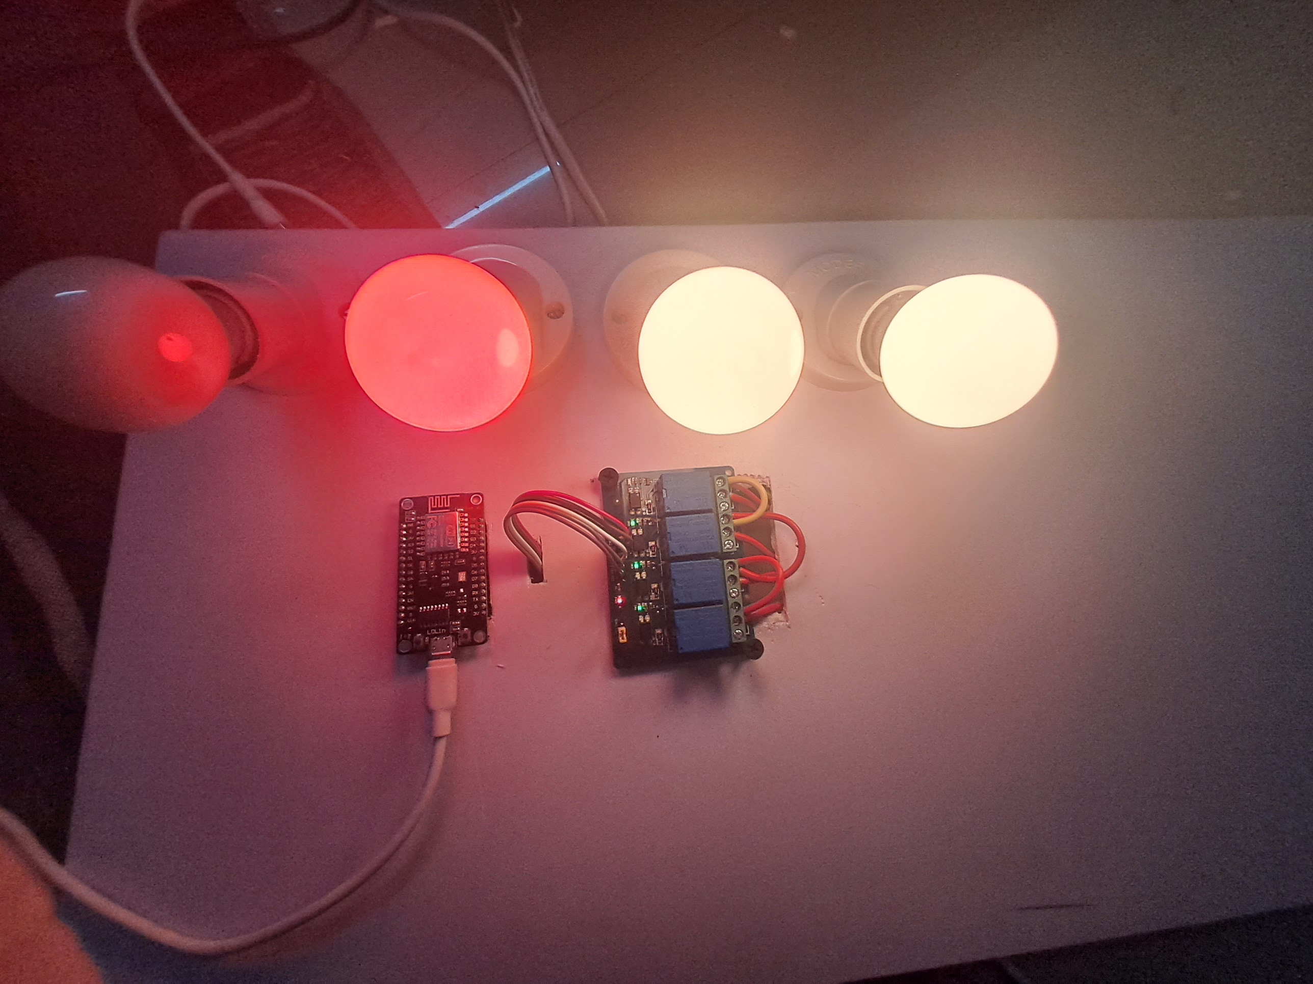
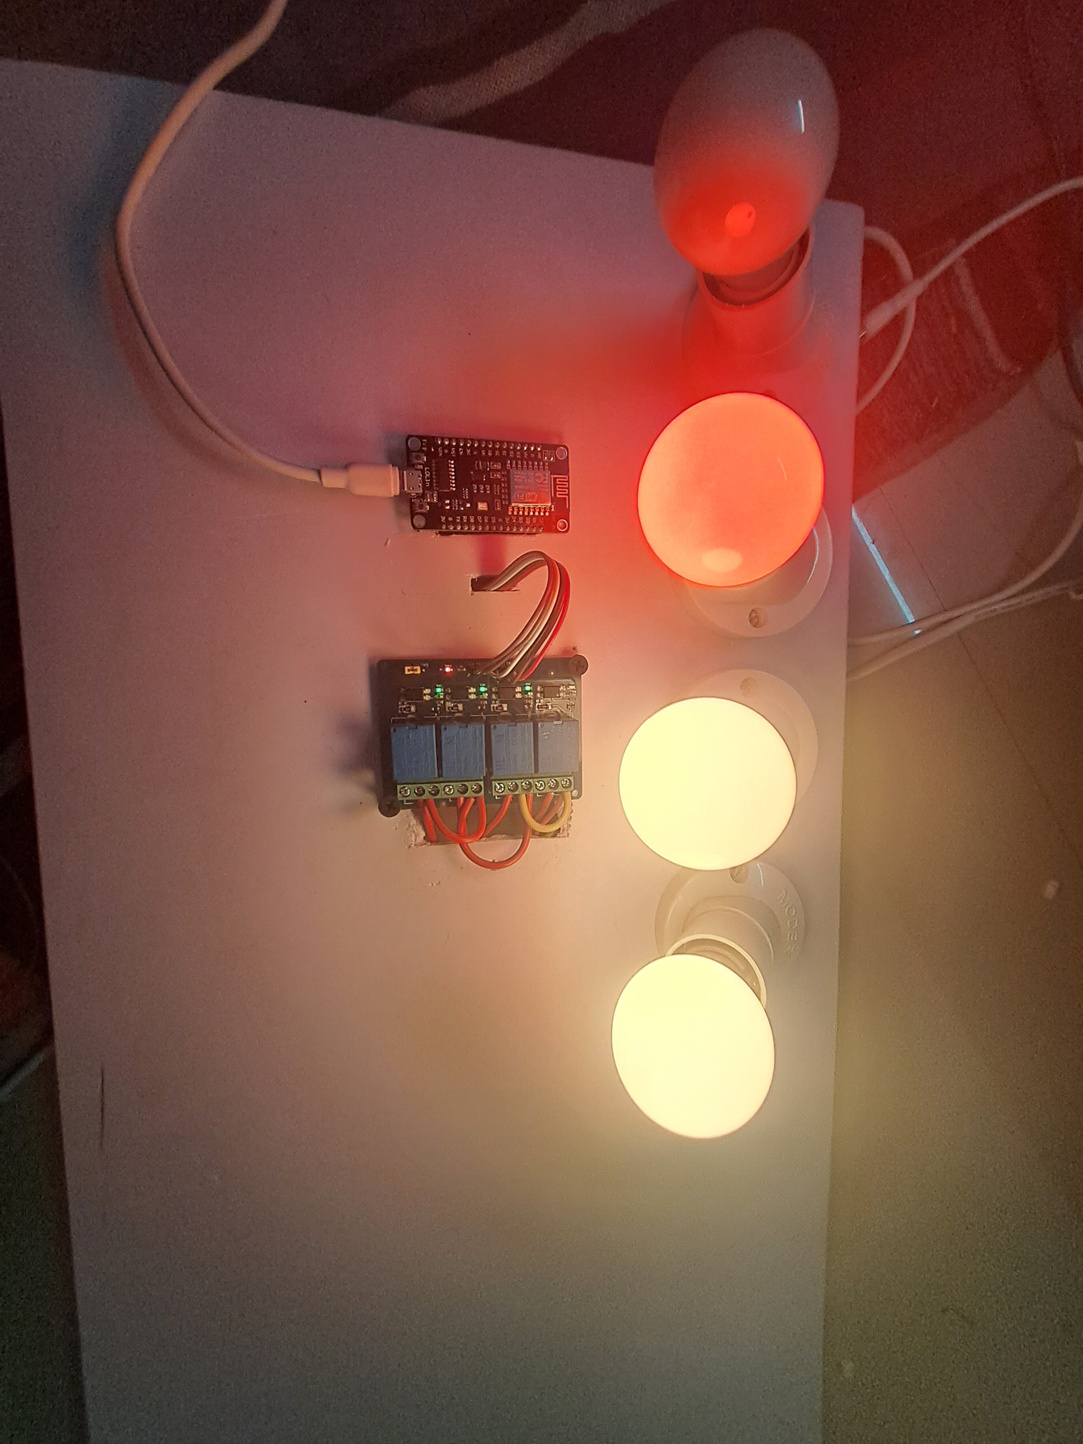
JADHAV ROSHAN SANTOSH
BORAKHADE KRISHNA RAVINDRA
ATKARI SHREYA VASANT
TY BTech, AY 2023-24 SEM-I, Course: Internet of Things
Instructor: Dr. Pravin G. Gawande
Poster presenter names who contributed to this presentation/PBL
TY BTech, AY 2023-24 SEM-I, Course: Internet of Things
Under the Guidance of
Introduction
Block diagram
Results
Name of conference where paper
submitted
Home automation has made it possible to have what is often referred to as a "Smart Home", a home that can detect and identify you, automatically adjust the lighting to your predefined taste, open doors automatically, play your favorite music, water your flower in the morning, switch on the security lights at night and switch them off in the morning, heat water for bathe and tea, stream to you anywhere in the world via internet a live video of what is happening in and around your premises. It make it possible to link lighting, entertainment, security, telecommunications, heating, and air conditioning into one centrally controlled system.
Hardware Setup
Methodology
Conclusion
The project follows a simple and straightforward methodology that can be easily implemented by anyone with basic knowledge of electronics and programming. This Project Automates and regulates the operation of various Electronic items in a Home or Building using an ESP8266 wi-fi module, and relays. The system and a mobile application on a smartphone or tablet are connected wirelessly by the wi-fi module, enabling the user to control the electronic gadgets from a distance.
ESP8266 is designed to read the input via wi-fi module and set the relay states appropriately. The relays are used to manage the power supply of the electronic gadgets. The state of the electronic devices is also stored in EEPROM memory so that they can be restored in the event of a power failure or system reset.
In Conclusion, This paper proposes a low cost, secure, ubiquitously accessible, auto configurable, remotely controlled solution. The approach discussed in the paper is novel and has achieved the target to control home appliances remotely using the Wi-Fi technology to connects system parts, satisfying user needs and requirements. Wi-Fi technology capable solution has proved to be controlled remotely, provide home security and is cost-effective as compared to the previously existing systems. Hence we can conclude that the required goals and objectives of home automation system have been achieved. The system design and architecture were discussed, and prototype presents the basic level of home appliance control and remote monitoring has been implemented. Finally, the proposed system is better from the scalability and flexibility point of view than the commercially available home automation systems.
References
K. M. Azad, M. J. Hossain, M. M. Hasan, and M. A. Islam, "Design and implementation of a Smart Home Automation system using ESP8266," in 2018 5th International Conference on Electrical Engineering.
BRACT’S, Vishwakarma Institute of Information Technology, Pune-48
Department of Electronics and Telecommunication Engineering
(An Autonomous Institute affiliated to Savitribai Phule Pune University)
(NBA and NAAC accredited, ISO 9001:2015 certified)

